Slide 1



Automatic Rhetorical Roles Classification for Legal Documents using LEGAL-TransformerOverBERT
Gabriele Marino, Daniele Licari, Praveen Bushipaka, Giovanni Comandé and Tommaso Cucinotta

Slide 2
[…] 29. In our view, it is the right time to inform all the government bodies, their agencies and instrumentalities that unless they have reasonable and acceptable explanation for the delay and there was bonafide effort, there is no need to accept the usual explanation that the file was kept pending for several months/years due to considerable degree of procedural red-tape in the process. The government departments are under a special obligation to ensure that they perform their duties with diligence and commitment. Condonation of delay is an exception and should not be used as an anticipated benefit for government departments. The law shelters everyone under the same light and should not be swirled for the benefit of a few. 30. Considering the fact that there was no proper explanation offered by the Department for the delay except mentioning of various dates, according to us, the Department has miserably failed to give any acceptable and cogent reasons sufficient to condone such a huge delay. Accordingly, the appeals are liable to be dismissed on the ground of delay. 23. In State of Uttar Pradesh v. Amar Nath Yadav (2014) 2 SCC 422 while reiterating the above decision, the Supreme Court declined to condone the delay of 481 days in the State filing a special leave petition against the judgment of the High Court of Allahabad 24. Consequently, the Court is not satisfied with the reasons offered for the extraordinary delay of 1271 days in filing ITA No. 453 of 2012 and the delay of 1876 days in filing ITA No. 464 of 2012. Accordingly CM Nos. 13614/2010 in ITA No. 453/2012 and CM No. 14085/2012 in ITA No. 464/2012 are dismissed. 25. The reasons for the delay of 426 days in re-filing ITA No. 453 of 2012 are also wholly unconvincing. CM No. 13616/2012 in ITA No. 453/2012 is also, therefore, dismissed. 26. With the dismissal of the aforementioned applications, the appeals ITA Nos. 453 and 464 of 2012 are also dismissed. S. MURALIDHAR, J VIBHU BAKHRU, J AUGUST 24, 2015 dn.

Slide 3

[…] 29. In our view, it is the right time to inform all the government bodies, their agencies and instrumentalities that unless they have reasonable and acceptable explanation for the delay and there was bonafide effort, there is no need to accept the usual explanation that the file was kept pending for several months/years due to considerable degree of procedural red-tape in the process. The government departments are under a special obligation to ensure that they perform their duties with diligence and commitment. Condonation of delay is an exception and should not be used as an anticipated benefit for government departments. The law shelters everyone under the same light and should not be swirled for the benefit of a few. 30. Considering the fact that there was no proper explanation offered by the Department for the delay except mentioning of various dates, according to us, the Department has miserably failed to give any acceptable and cogent reasons sufficient to condone such a huge delay. Accordingly, the appeals are liable to be dismissed on the ground of delay. 23. In State of Uttar Pradesh v. Amar Nath Yadav (2014) 2 SCC 422 while reiterating the above decision, the Supreme Court declined to condone the delay of 481 days in the State filing a special leave petition against the judgment of the High Court of Allahabad 24. Consequently, the Court is not satisfied with the reasons offered for the extraordinary delay of 1271 days in filing ITA No. 453 of 2012 and the delay of 1876 days in filing ITA No. 464 of 2012. Accordingly CM Nos. 13614/2010 in ITA No. 453/2012 and CM No. 14085/2012 in ITA No. 464/2012 are dismissed. 25. The reasons for the delay of 426 days in re-filing ITA No. 453 of 2012 are also wholly unconvincing. CM No. 13616/2012 in ITA No. 453/2012 is also, therefore, dismissed. 26. With the dismissal of the aforementioned applications, the appeals ITA Nos. 453 and 464 of 2012 are also dismissed. S. MURALIDHAR, J VIBHU BAKHRU, J AUGUST 24, 2015 dn.
Analysis
Ratio of the decision
Precedent relied
Rouling by present court
…

Slide 4
LEGAL-BERT baseline
LEGAL-TransformerOverBERT (LEGAL-ToBERT)
Relative Sinusoidal Positional Encoding
Results on ITA-RhetRoles Dataset
Results on BUILD Dataset

Slide 5
LEGAL-BERT baseline
LEGAL-TransformerOverBERT (LEGAL-ToBERT)
Relative Sinusoidal Positional Encoding
Results on ITA-RhetRoles Dataset
Results on BUILD Dataset

Slide 6


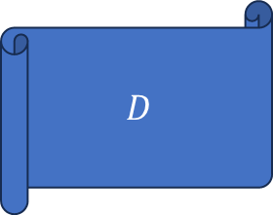


$$S_{1}$$
$$S_{2}$$
$$D$$
$$S_{d}$$

Slide 7



Slide 8
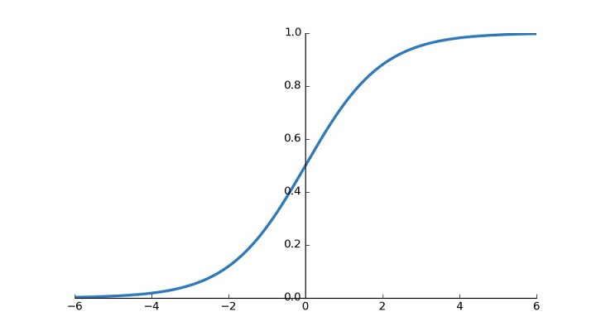







$$S_{1}$$
$$CLS_{1}$$
$$S_{2}$$
$$CLS_{2}$$
$$D$$
$$S_{d}$$
$$CLS_{d}$$

Slide 9
LEGAL-BERT baseline
LEGAL-TransformerOverBERT (LEGAL-ToBERT)
Relative Sinusoidal Positional Encoding
Results on ITA-RhetRoles Dataset
Results on BUILD Dataset

Slide 10
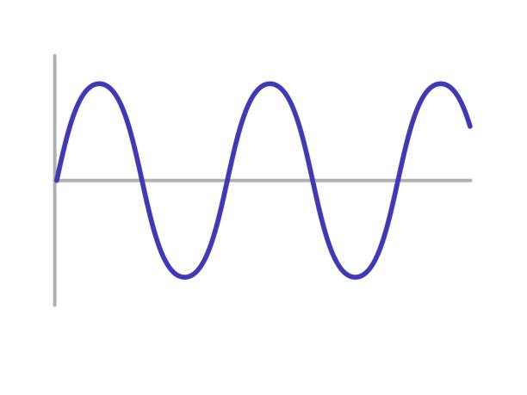







T
R
A
N
S
F
O
R
M
E
R
E
N C O D
E R
$$S_{1}$$
$$CLS_{1}$$
$$S_{2}$$
$$CLS_{2}$$
$$D$$
$$S_{n}$$
$$CLS_{n}$$

Slide 11
LEGAL-BERT baseline
LEGAL-TransformerOverBERT (LEGAL-ToBERT)
Relative Sinusoidal Positional Encoding
Results on ITA-RhetRoles Dataset
Results on BUILD Dataset

Slide 12


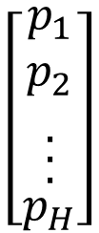
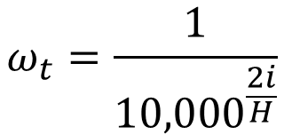
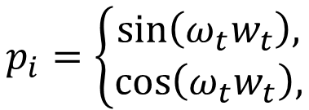
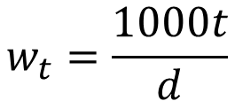


$$CLS_{t}$$
$$0<t<d<n$$
$$H=768$$
$$\left[\begin{aligned}\begin{aligned}\begin{aligned}\begin{aligned}p_{1} \\ p_{2} \\ .\end{aligned} \\ .\end{aligned} \\ .\end{aligned} \\ p_{H}\end{aligned}\right]$$
$$ω_{t}=\frac{1}{{10,000}^{\frac{2i}{H}}}$$
$$p_{i}=\left\{\begin{matrix}\sin\left(ω_{t}w_{t}\right), \\ \cos\left(ω_{t}w_{t}\right),\end{matrix}\right.$$
if i is even
if i is odd
Absolute Embedding
Relative Embedding
$$w_{t}=\frac{1000t}{d}$$
$$w_{t}=t$$

Slide 13
LEGAL-BERT baseline
LEGAL-TransformerOverBERT (LEGAL-ToBERT)
Relative Sinusoidal Positional Encoding
Results on ITA-RhetRoles Dataset
Results on BUILD Dataset

Slide 14
5 Rhetorical Roles:
Introduction (INT)
Conclusions of the parties (CP)
Summary of the appealed judgment (SAJ)
Legal reasons (LR)
Decisional content (DC)

Slide 15
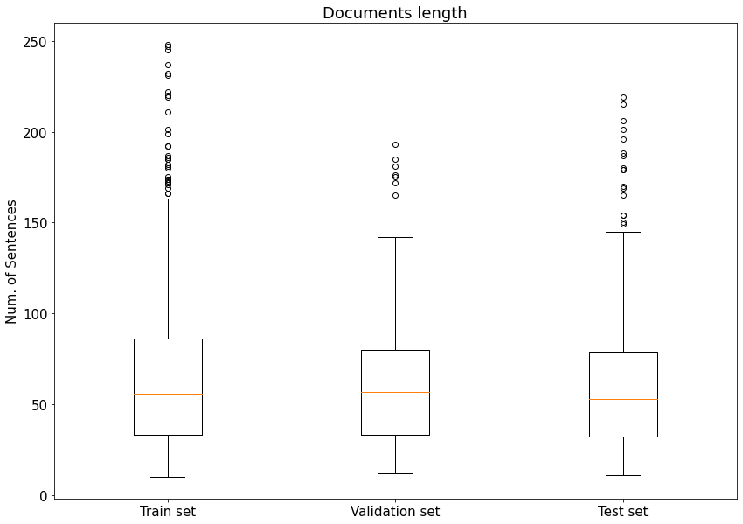
 | # Documents | # Sentences
Train | 1045 | 68,012
Validation | 149 | 9,620
Test | 294 | 18,288

Slide 16
 | LEGAL-BERT | LEGAL-ToBERT
Accuracy | 0.872 | 0.982
MCC | 0.806 | 0.972
Macro F1 | 0.878 | 0.980
Micro F1 | 0.872 | 0.982
Macro P | 0.871 | 0.979
Micro P | 0.872 | 0.982
Macro R | 0.889 | 0.980
Micro R | 0.872 | 0.982
RR | LEGAL-BERT |  |  | LEGAL-ToBERT
 | F1 | P | R | F1 | P | R
INT | 0.990 | 0.985 | 0.994 | 0.994 | 0.994 | 0.995
CP | 0.896 | 0.866 | 0.935 | 0.990 | 0.986 | 0.993
SAJ | 0.849 | 0.861 | 0.839 | 0.984 | 0.984 | 0.984
LR | 0.912 | 0.912 | 0.912 | 0.986 | 0.986 | 0.986
DC | 0.951 | 0.957 | 0.945 | 0.980 | 0.983 | 0.979

Slide 17
LEGAL-BERT baseline
LEGAL-TransformerOverBERT (LEGAL-ToBERT)
Relative Sinusoidal Positional Encoding
Results on ITA-RhetRoles Dataset
Results on BUILD Dataset

Slide 18
13 Rhetorical Roles:
Preamble (PRE)
Facts (FAC)
Ruling by Lower Court (RLC)
Issues (ISSUE)
Argument by petitioner (ARGP)
Argument by respondent (ARGR)
Analysis (ANA)
Statue (STA)
Precedent relied (PRER)
Precedent not relied (PRENR)
Ratio of the decision (RAT)
Ruling by Present Court (RPC)
None of the others (NONE)

Slide 19
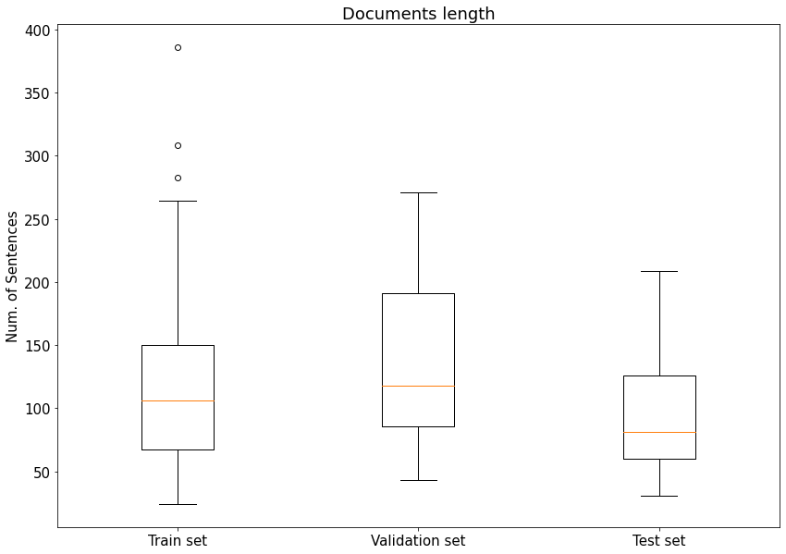
 | # Documents | # Sentences
Train | 221 | 25,752
Validation | 24 | 3,234
Test | 30 | 2,879

Slide 20
 | LEGAL-BERT | LEGAL-ToBERT
Accuracy | 0.656 | 0.785
MCC | 0.559 | 0.727
Macro F1 | 0.472 | 0.574
Micro F1 | 0.656 | 0.785
Macro P | 0.532 | 0.623
Micro P | 0.656 | 0.785
Macro R | 0.457 | 0.564
Micro R | 0.656 | 0.785
RR | LEGAL-BERT |  |  | LEGAL-ToBERT
 | F1 | P | R | F1 | P | R
PRE | 0.837 | 0.875 | 0.810 | 0.972 | 0.965 | 0.980
FAC | 0.789 | 0.771 | 0.816 | 0.873 | 0.877 | 0.869
RLC | 0.633 | 0.703 | 0.602 | 0.712 | 0.794 | 0.668
ISSUE | 0.890 | 0.926 | 0.859 | 0.886 | 0.876 | 0.898
ARGP | 0.646 | 0.650 | 0.642 | 0.575 | 0.637 | 0.554
ARGR | 0.497 | 0.493 | 0.500 | 0.698 | 0.681 | 0.719
ANA | 0.744 | 0.740 | 0.761 | 0.844 | 0.836 | 0.862
STA | 0.802 | 0.802 | 0.802 | 0.805 | 0.769 | 0.854
PRER | 0.697 | 0.832 | 0.645 | 0.732 | 0.784 | 0.697
PRENR | 0.499 | 0.498 | 0.500 | 0.499 | 0.498 | 0.500
RAT | 0.520 | 0.655 | 0.514 | 0.609 | 0.784 | 0.570
RPC | 0.898 | 0.879 | 0.919 | 0.936 | 0.950 | 0.922
NONE | 0.892 | 0.912 | 0.869 | 0.951 | 0.972 | 0.933

Slide 21
Contributions
Release of LEGAL-ToBERT and Italian-LEGAL-ToBERT, ready-to-use high-performance AI models for legal rhetorical roles classification.
Italian-LEGAL-ToBERT is the first Italian model for legal rhetorical roles classification.
For limited resources environments, release of LEGAL-BERT and Italian-LEGAL-BERT fine-tuned versions for legal rhetorical roles classification.
Relative Sinusoidal Positional Embedding: a positional embedding strategy outperforming the classical one in legal rhetorical roles classification.

Slide 22
Future Works
Use Rhetorical Roles Classification to improve the performances of Legal Holding Extraction models.
The bigger the better? Try to use more recent Large Language Models to improve the classification accuracy.
Can Chat-GPT help?

